Slide 1

Predicting Telecom Customer Churn
MSDS-2024-124 | Data Science Project

Slide 2

Outline
Introduction and Objective
Dataset Overview
Data Cleaning (Handling Missing Values)
Exploratory Data Analysis (EDA)
- Churn Distribution
- Numerical and Categorical Feature Analysis
Correlation Analysis
Data Preparation (Splitting and Scaling)
Model Training and Evaluation
Hyperparameter Tuning
Feature Importance
Conclusion and Future Work

Slide 3
Introduction and Objective
This project aims to predict customer churn in a telecom dataset using machine learning techniques.
Churn prediction helps businesses retain customers by identifying patterns leading to attrition.

Slide 4
Dataset Overview
Dataset
Kaggle contains 7043 rows and 33 features.
Key features:
Contract, Monthly Charges, Tenure, Payment Method, etc.
Target variable:
Churn Label (Yes/No).

Slide 5

Data Cleaning
Missing values handled in 'Total Charges'.
Dropped irrelevant columns like CustomerID, Lat Long, Country, and State.
Ensured no missing values in the cleaned dataset.

Slide 6
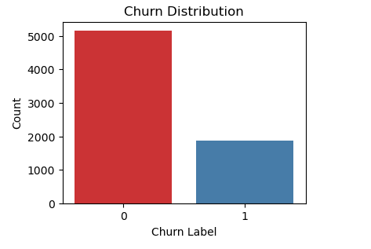
Exploratory Data Analysis (EDA) Churn Distribution

Slide 7
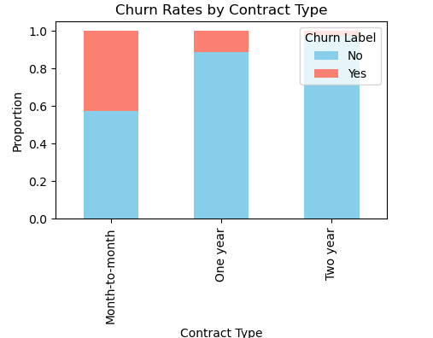
Categorical Feature Analysis

Slide 8
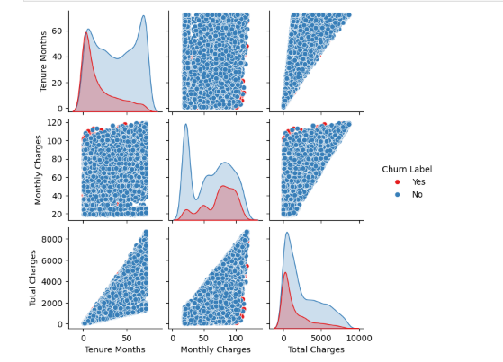
Numerical Feature Distribution

Slide 9
Correlation Analysis
Analyzed feature correlation with Churn Value.
Strongest correlation Monthly Charges and Tenure Months.
Visualized correlations using heatmaps.

Slide 10
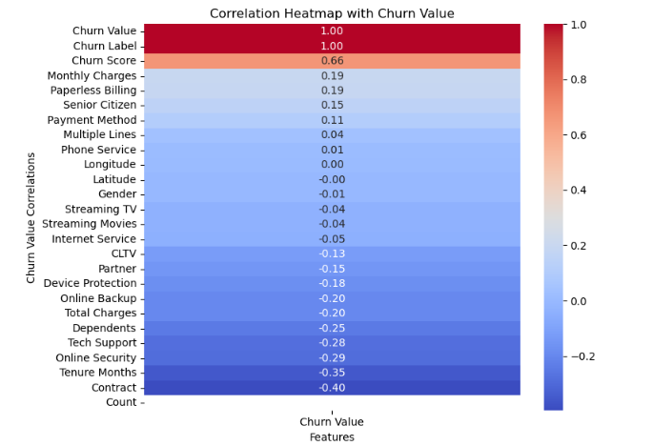

Slide 11
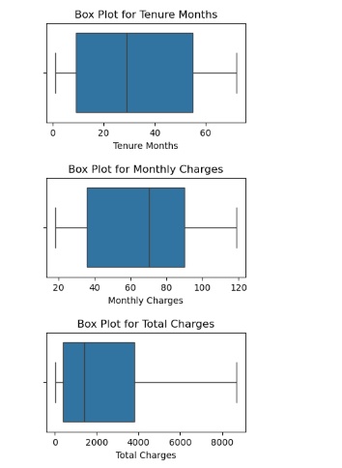
Detecting Outliers

Slide 12
Data Preparation (Splitting and Scaling)
Split dataset into training and testing sets:
X_train, X_test, y_train, y_test = train_test_split(X, y, test_size=0.3, random_state=42, stratify=y)
Scaled numerical features:
scaler = StandardScaler()
X_train_scaled = scaler.fit_transform(X_train)
X_test_scaled = scaler.transform(X_test)

Slide 13
Model Training and Evaluation
Random Forest
Accuracy, Precision, Recall, F1-Score.
Logistic Regression
Accuracy: 81%
F1-Score (weighted): 0.81

Slide 14
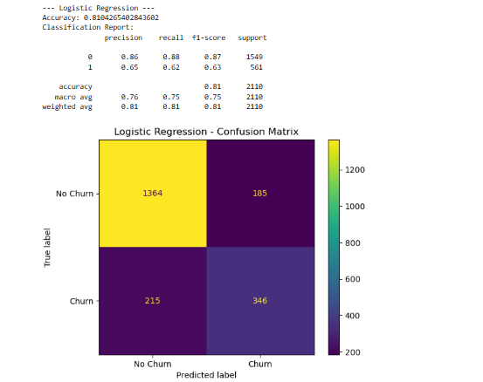
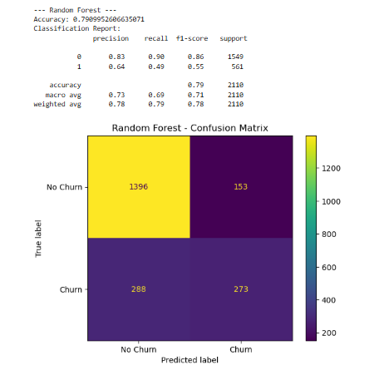
Confusion Matrix

Slide 15
Hyperparameter Tuning
Optimized Random Forest using GridSearchCV.
Tuned parameters: max_depth, min_samples_split, n_estimators.
Best Parameters: {'max_depth': 10, 'min_samples_split': 5, 'n_estimators': 200}

Slide 16
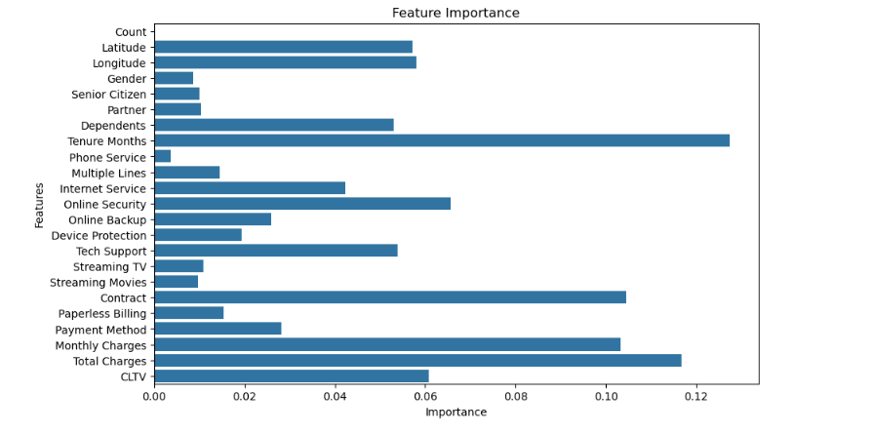
Feature Importance

Slide 17
Conclusion and Future Work
Logistic Regression is the best-performing model for this dataset.
Random Forest can be improved further with additional tuning or feature engineering.
Future Work
Explore advanced models like XGBoost.
Investigate additional features or external datasets.

